Slide 1



Day 35
contact@anubhavtrainings.com
ABAP RESTFUL APPLICATION PROGRAMMING

Slide 2

Agenda – Day 35
Booking Supplement Example
Drill Down to level three for processor
What is ABAP Git
Why we use ABAP Git
ABAP Git Integration
Understand How to Use ABAP Git

Slide 3
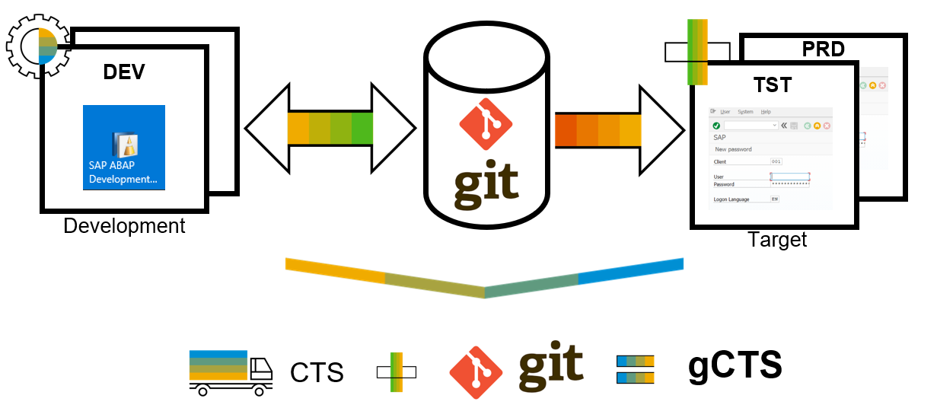
What is ABAP Git ?
abapGit is a tool to import and export code between ABAP systems. If a developer has a developer key to the system, the developer can perform these actions already. abapGit enables the developer to do mass export/changes/imports but not more than already possible to do manually.
Running automated security checks on the abapGit code will by design give a lot of errors, as abapGit will import, overwrite and change ABAP artifacts in the system in ways that might not be intended. Always review all code in remote repositories before importing to the target system, this is possible because abapGit is plain text unlike traditional transport files.
That being said, abapGit is used by mutiple organizations, all abapGit changes are reviewed via pull requests. And all 100+ repository watchers are automatically notified for every change to the code base, so potentially all changes are looked at by more people than tradtional enterprise products.

Slide 4
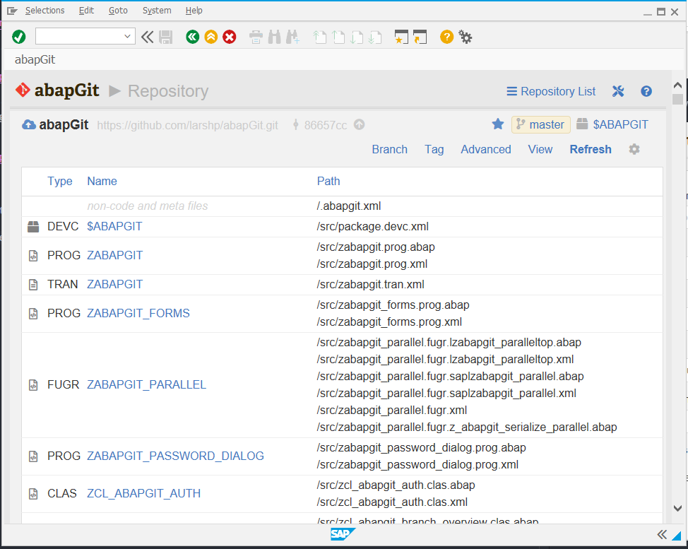
ABAP Git
It is a community effort to support the project, recommend watching the project to get a feeling about issue resolution. Everyone can suggest changes to abapGit via pull requests.

Slide 5
What is SAP HANA?

Slide 6
What is SAP HANA?

Slide 7
What is SAP HANA?

Slide 8
What is SAP HANA?

Slide 9
What is SAP HANA?

Slide 10
What is SAP HANA?

Slide 11
What is SAP HANA?

Slide 12
What is SAP HANA?

Slide 13

End of Day 35
Trainer: Anubhav Oberoy

Slide 14

Trainer: Anubhav Oberoy

Slide 15
THANK YOU
If you cannot do
great things, do small things in a great way.
Anubhav Oberoy
https://www.anubhavtrainings.com

Slide 16


We’re committed to empower you to be
Most Desirable Resource
through powerful training solutions.
We build the workforce of the future.
250+
Corporate Clients
30,000+
Learners Trained
25000+
Learners Placed
FREE WEBINARS
Sign up for free webinars with industry experts every fortnight!
Enroll Now!
Contact us today!
https://anubhavtrainings.com/

Slide 17




More from AnubhavTrainings.com

